Slide 1

Section 2.2 Graphs of Functions
Lecture 1
Graph features
Basic functions and their graphs

Slide 2

Section 2.2 Homework Submission to Canvas
Preview of section
Skim the section in text and write a short paragraph summary.
Give a bulleted list of all important definitions, theorems, and formulas without details.
Notes on video lectures
Take notes on everything written on slides including all details, worked examples, on-own activities, as well as your own thoughts and questions.
Try on-own activities first, then write down provided solution next to it for comparison.
Worked examples from the text
Write down the problem and attempt without looking at the solution.
Use the solution to write the best explanation you can.
Solutions to textbook exercises
Model approaches and explanations given in the video lectures and textbook examples.
Final reflection of section
List the key takeaways to remember as a bulleted list.

Slide 3
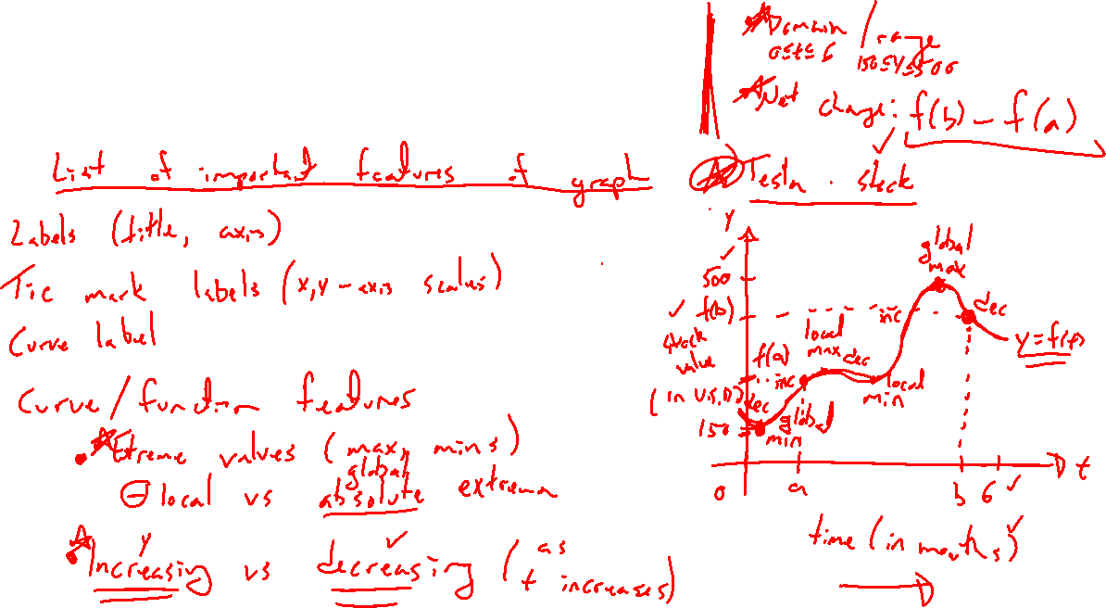
Graph Features: Stock Prices
Notes:
Google tesla stock
Graph labels important
Is this a function? What is x, y. Domain / range
Key features: Inc / dec, max / min (local and global)
Net change: f(b)-f(a)
Hard to find precise values with graph, better to have a formula f(x). Not doable here.

Slide 4
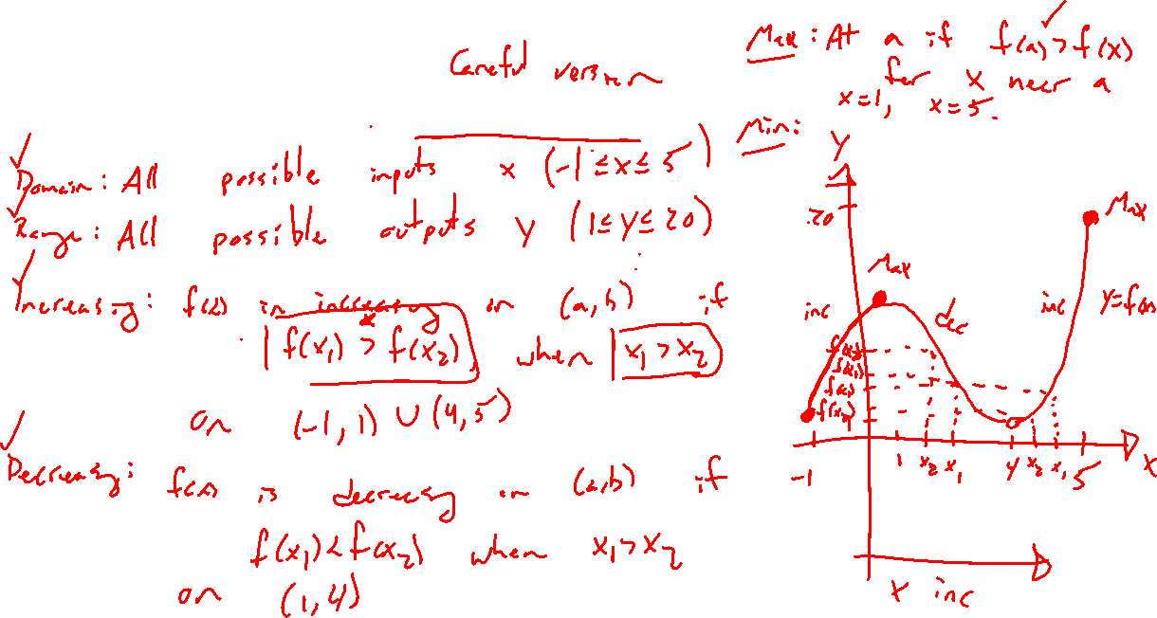
Graph Features: Definitions
Notes:
Y=f(x), general graph on side
Vertical line test
Domain / range
Inc / dec
Max / min

Slide 5
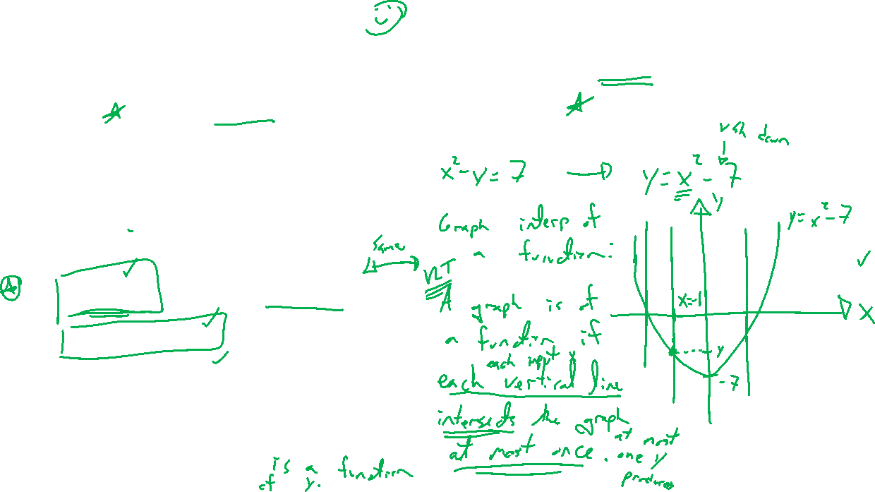
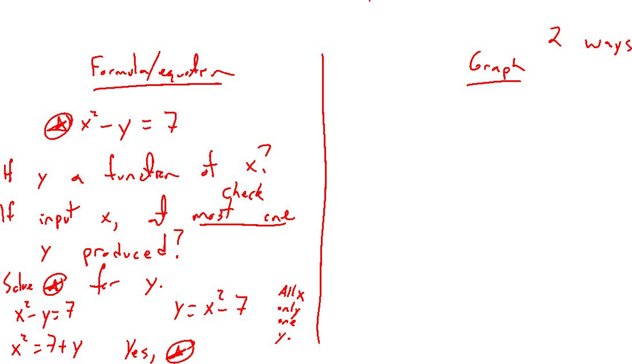
Example: Determine if Function of x
Notes:
x^2-y=7
Equation and graph approach
Domain and range
Desmos

Slide 6
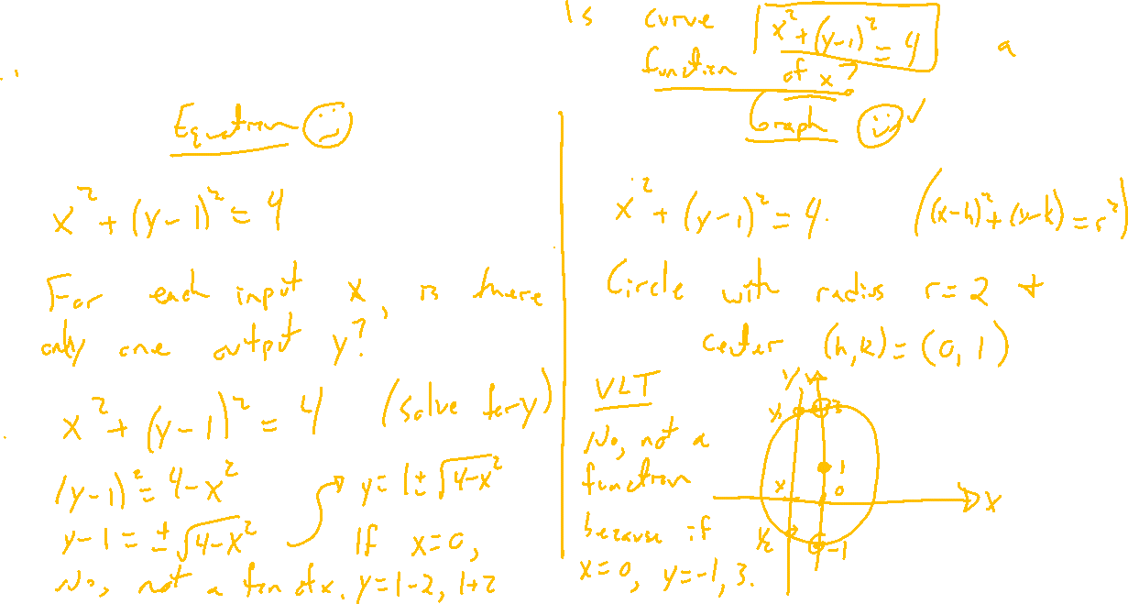
Example: Try on Own
Notes:
X^2+(y-1)^2=4
Equation and graph approach
Domain and range
Desmos

Slide 7
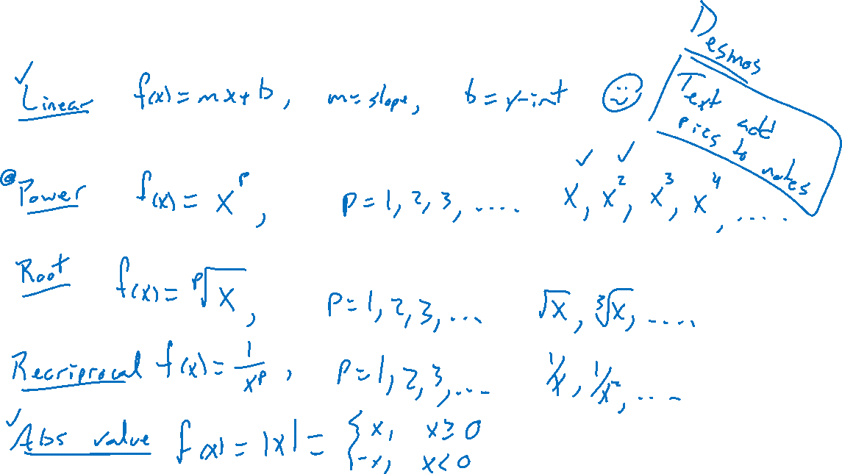
Classes of Functions and Their Graphs
Notes:
Linear: f(x)=mx+b
Powers: x^n
Root: \sqrt[n]{x}
Recriprocal: 1/x^n
Abs value: |x|
Desmos
Will modify these later to grow complexity.

Slide 8

Section 2.2: Textbook Examples and Exercises
Rework examples 1, 3, 4, 6, 8, 9 in the text. Steps:
Write down a problem.
Close the book and attempt on own.
Check / correct your solution against the text solution.
If needed, rewrite the problem to be of the quality of the text solution.
Complete exercises 11, 19, 25, 45, 49, 51, 53, 61
Write solutions of the same quality as in lecture and text solutions.
Check your solution against the answer in the back of the book.

Slide 9

Section 2.2 Homework Submission to Canvas
Preview of section
Skim the section in text and write a short paragraph summary.
Give a bulleted list of all important definitions, theorems, and formulas without details.
Notes on video lectures
Take notes on everything written on slides including all details, worked examples, on-own activities, as well as your own thoughts and questions.
Try on-own activities first, then write down provided solution next to it for comparison.
Worked examples from the text
Write down the problem and attempt without looking at the solution.
Use the solution to write the best explanation you can.
Solutions to textbook exercises
Model approaches and explanations given in the video lectures and textbook examples.
Final reflection of section
List the key takeaways to remember as a bulleted list.

